Slide 1
Introduction to Blockchain
Kiran R K
Principal – Data and Analytics

Slide 2
Forewarning: This may contain mistakes, Blockchain is still an evolving technology
When did you become expert in Blockchain?
Last Night

Slide 3
Learning Objective
Applications of Blockchain technology
Other Cryptocurrencies
Smart contract
DAO, dAPP
Future trends
Blockchain History
Need for block Chain
Why is it important to know about Blockchain?
Bitcoin Basics
Technologies behind Blockchain / Bitcoin
How does a Blockchain get verified?
Forking and attacks on Bitcoin
JARGONS
Blockchain
Cryptography
Hash functions
Distributed Consensus
Proof or Work
Double Spending
Merkle Tree
Miners
Forking
SegWit
Ethereum
Smart Contract
Oracles
Whisper
DAO
dAPP
Cryptocurrencies

Slide 4
What is Block Chain

Slide 5
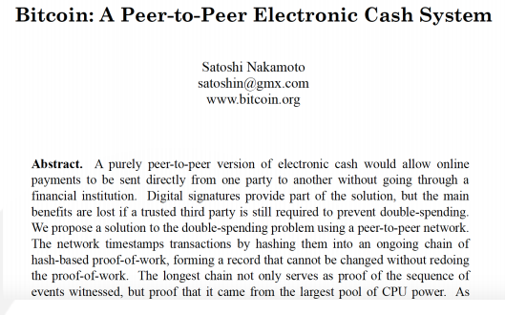

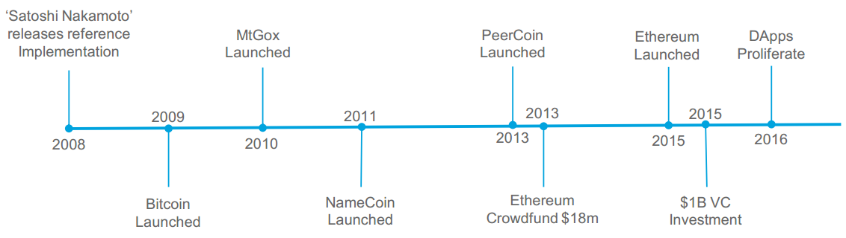
Blockchain History
Blockchain was first conceptualized by Satoshi Nakamoto in 2008 in his paper about Bitcoin.
Introduced in the midst of the financial crisis, to serve as the ledger for Bitcoin, a purely peer-to-peer version of electronic cash
Blockchain is a distributed database that maintains a continuously growing list of records called blocks secured from tampering and revision.
A blockchain is a historical record of all the transactions that have taken place since the beginning of the blockchain in the network. The blockchain serves as a single source of truth for the network.

Slide 6
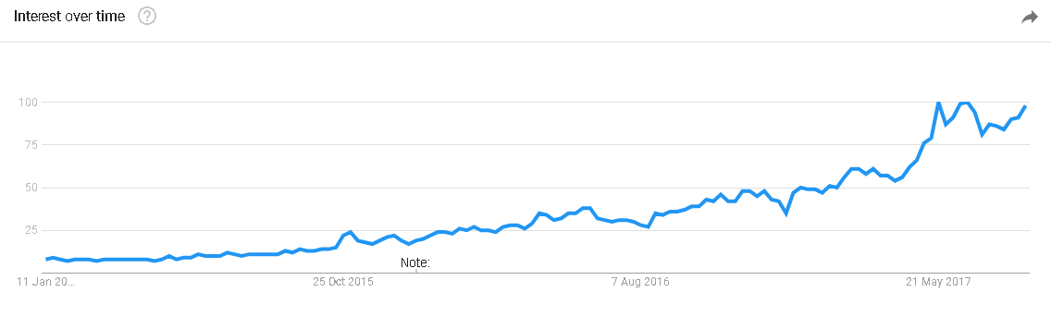
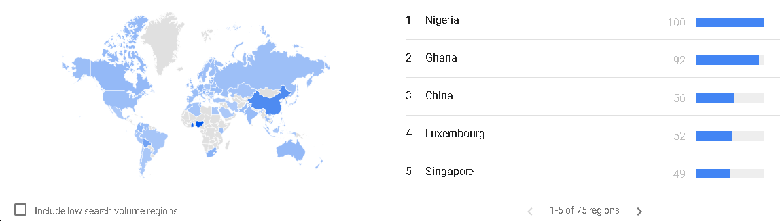
Interest in Blockchain over the years
2015
2017
Notes:
Within India

Slide 7
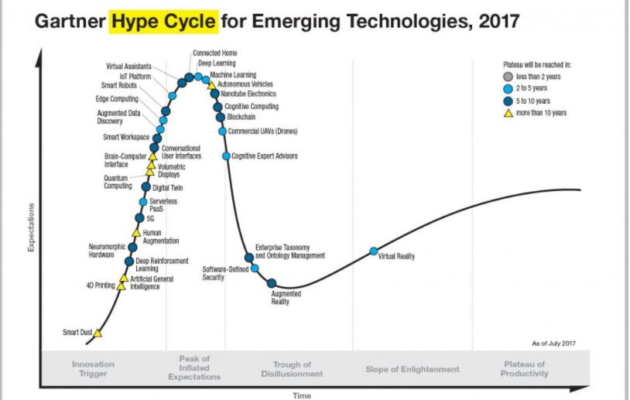
Gartner Hype Cycle for Emerging Technologies 2017
Notes:
How Do You Use Hype Cycles?
Clients use Hype Cycles to get educated about the promise of an emerging technology within the context of their industry and individual appetite for risk.
Should you make an early move? If you're willing to combine risk taking with an understanding that risky investments don't always pay off, you could reap the rewards of early adoption.
Is a moderate approach appropriate? Executives who are more moderate understand the argument for an early investment but will also insist on a sound cost/benefit analysis when new ways of doing things are not yet fully proven.
Should you wait for further maturation? If there are too many unanswered questions around the commercial viability of an emerging technology, it may be better to wait until others have been able to deliver tangible value.
How Do Hype Cycles Work?
Each Hype Cycle drills down into the five key phases of a technology's life cycle.
Innovation Trigger: A potential technology breakthrough kicks things off. Early proof-of-concept stories and media interest trigger significant publicity. Often no usable products exist and commercial viability is unproven.
Peak of Inflated Expectations: Early publicity produces a number of success stories — often accompanied by scores of failures. Some companies take action; many do not.
Trough of Disillusionment: Interest wanes as experiments and implementations fail to deliver. Producers of the technology shake out or fail. Investments continue only if the surviving providers improve their products to the satisfaction of early adopters.
Slope of Enlightenment: More instances of how the technology can benefit the enterprise start to crystallize and become more widely understood. Second- and third-generation products appear from technology providers. More enterprises fund pilots; conservative companies remain cautious.
Plateau of Productivity: Mainstream adoption starts to take off. Criteria for assessing provider viability are more clearly defined. The technology's broad market applicability and relevance are clearly paying off.
HYPE CYCLES HELP YOU:
Separate hype from the real drivers of a technology's commercial promise
Reduce the risk of your technology investment decisions
Compare your understanding of a technology's business value with the objectivity of experienced IT analysts
RESOURCES
Gartner Magic Quadrant FAQ
Publication Calendar
CONTACT GARTNER
methodologies@gartner.com
General Contacts
Become a Gartner Client

Slide 8
Distributed Ledger
A distributed ledger is a type of database, or system of record, that is shared, replicated, and synchronized among the members of a network. The distributed ledger records the transactions, such as the exchange of assets or data, among the participants in the network. This shared ledger eliminates the time and expense of reconciling disparate ledgers.
Benefits of distributed ledgers
Participants in the network govern and agree by consensus on the updates to the records in the ledger. No central, third-party mediator, such as a bank or government, is involved. Every record in the distributed ledger has a timestamp and unique cryptographic signature, thus making the ledger an auditable history of all transactions in the network.
An industry standard for distributed ledgers
One implementation of distributed ledger technology is the open source Hyperledger Fabric blockchain, which is one of several open source projects hosted by The Linux Foundation.

Slide 9



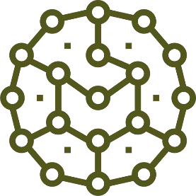

Distributed Ledger : Blockchain
Blockchain creates a permanent, time-stamped record of all transactions that is mathematically secured from alteration through cryptography.
Conventional Central Ledger
Distributed Ledger by Blockchain
Blockchain allows untrusting parties with common interests to co - create a permanent, unchangeable and transparent record of exchange without relying on a central authority..

Slide 10
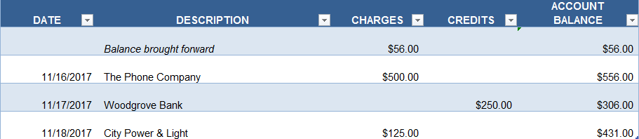
Blockchain Defined
Distributed
Secure
Logfile
Ledger
Constantly Growing
Permanent
Immutable
Chronological
Secure

Slide 11
Participants
A blockchain network for business is a collectively owned peer-to-peer network that is operated by a group of identifiable and verifiable participants.
Participants may be individuals or institutions, such as a business, university, or hospital, for example.

Slide 12
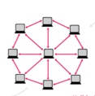
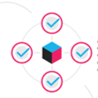



Working of Blockchain
Validation
The network of Nodes.
A verified transaction can involve cryptocurrency, contracts, records and other information.
Someone requests a transaction.
The requested transaction is broadcasted into a P2P network consisting of computers in a node.
The Transaction is complete
The new block is then added to the block chain. In a way that is permanent and immutable.

Slide 13
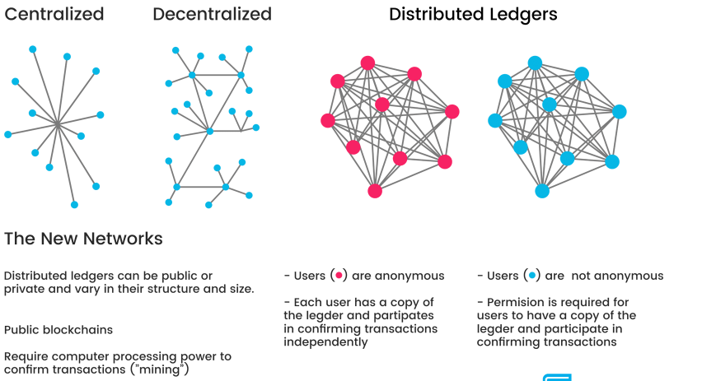
Ledgers Type

Slide 14

Permissioned and Non-permissioned Blockchain
The Blockchain envisaged by its founders and the initial developers is open to all , anybody can join the network, and the Blockchain protocol ensures trust. This is called Non-permissioned Blockchain, ex: Bitcoin and Ethereum Blockchain
This gets rid of any central authority like banks or any other institutions
So during the Initial stages of Blockchain development, these institutions ignored it, then they try to ridicule it , later realized they could not ignore it any more and found ways to adapt it to their needs, without loosing their authority. Thus born Permissioned Blockchain
In Permissioned Blockchain the identity of the participants are known and are trusted .
Since the participants are trusted there is no need for “mining”
The responsibility of adding a block is assigned by the code creators rather than by lottery for non-permissioned Blockchain.
Hyperledger is a Blockchain development platform by Linux Foundation for creating enterprise class permissioned Blockchain apps

Slide 15
Cryptographic challenge
All the transactions are broadcasted to the Blockchain network and is stored in a temporary memory called mempool.
The next step is to create a block. A block contains multiple transactions done within a certain period. Creating the new block is structured as a cryptographic puzzle which needs to be solved by miners.
Any node can become a miner who has enough CPU power.
To understand cryptographic challenge we need to understand hash algorithms and the concept of Merkle tree

Slide 16
Mechanism of Hash
A cryptographic hash function takes as input, a string of arbitrary length and returns a string with predetermined length.
Length of output always the same
Digital Fingerprint
One-Way
Hash Function
Value of specific digit number
Data
Hash Function
e807f1fc
12345678 90
Much difference by small change
12345678 91
Hash Function
0f7e44a92

Slide 17
Building Blocks using Hash - Findings
Index
Prev
Payload
Hash
Index
Prev
Payload
Hash
Index
Prev
Payload
Hash
Index
Prev
Payload
Hash
N-2
N-1
N
N+1
A hash chain is a sequence of records in which each record contains the hash of the previous record in the chain, and the hash of all the current record’s contents
Blockchain uses a cryptographic hash function like SHA256.
Nobody can find two inputs with the same hash value
Hash chains have the property that every record contains a commitment to all previous records.
Record N contains a commitment to record N which contains a commitment to record N-1, which contains a commitment to record N-3, and so on
If you change record N, this changes the final hashes of records N+1, N+2, ...
Result: Once we all accept record N, we have locked in the contents of record 1, 2, 3, ..., N-1 as well

Slide 18
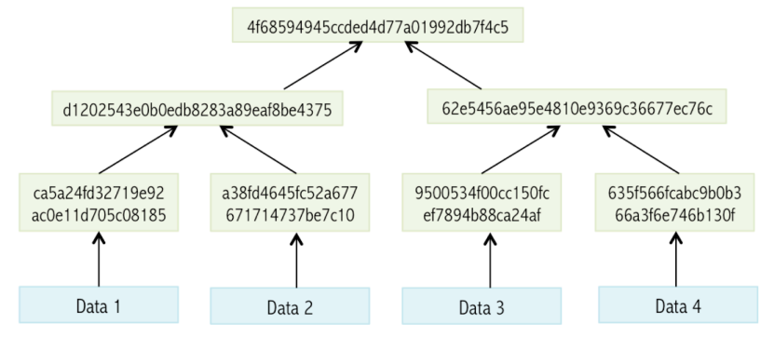
Merkle Tree
Merkle tree is the hash of the hashes
A tree constructed by hashing paired data (the leaves), then pairing and hashing the results until a single hash remains, the Merkle root.
A block of one or more new transactions is collected into the transaction data part of a block.
Copies of each transaction are hashed, and the hashes are then paired, hashed, paired again, and hashed again until a single hash remains called Merkle Root
Merkle Root

Slide 19
Public / Private Key Cryptography
Two large prime numbers that have a mathematical relation with each other
A string encrypted with one key can only be decrypted with the other
One key needs to be kept private, the other one can be made publicly known
This can be used by other parties to exchange data with you in a secure manner.
Private keys need to be stored that it is accessible only for owner.
This can be done on personal devices (PC, smart card, USB stick, phone, ...) or remotely with a service provider (cold and hot wallets).

Slide 20
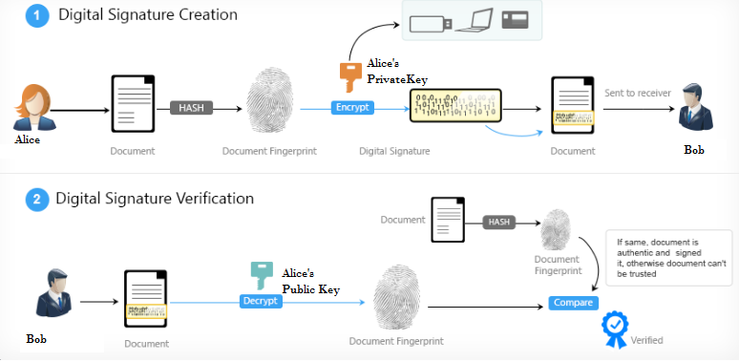
Digital Signature Creation
Digital signatures ensures authentication, non- repudiation and integrity of the message

Slide 21
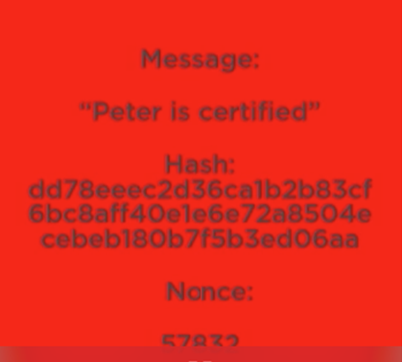
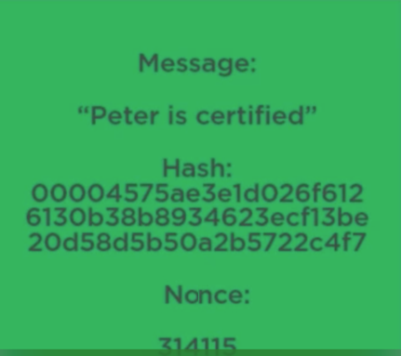
Building A Block using Hash
Building a block using transactions and hash should have a very important criteria in mind. It should be difficult to create but easy to verify

Slide 22
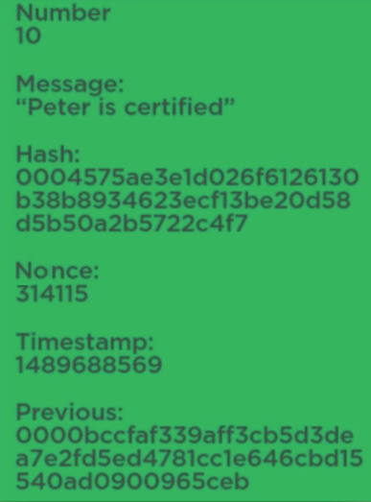
Building Blockchain Contd..
Nonce
Nonce

Slide 23
Simplified Block Structure
Nonce
Each new block is “chained” to the previous block, in
linear, chronological order
Previous Block
Proof of Work
***
Timestamp
Merkle
Block 98
Transaction’s ID list
Block 99
Merkle Tree Hash
Block 100
Block 101
1 MB Block size limit was introduced by Satoshi foreseeing DOS attacks using dummy transactions
***
1 MB block size can have only 4.4 transactions per second, 65% of it is signature data

Slide 24
Block Height and Transaction Immutability
Blocks are normally referenced from their Block height number, i.e how many blocks from the first block created in 2009
Block depth is the depth of the Block of Interest (which contains Alice’s Transaction) from the latest Block.
The deeper a particular block is from the latest block, the more difficult it is to alter the transactions in that Block.
This does not mean that the later Blocks are easier altered. This illustration just explains that it is relatively more difficult to alter (double spend etc) the transactions as we go deeper in the earlier chain of Blocks
This makes the records ‘immutable’ or cannot be altered after creation
Block 277318
Transactions
Latest block
Block Depth
Depth
Block 277317
Transactions
Difficulty
Block 277316
Alice’s Transactions
Block of interest
Block 277315
Transactions
Block Height
Block 277314
Transactions

Slide 25

Security Increases as more blocks added
Block 277318
Transactions
Latest block
Block Depth
Less Secure
Depth
Block 277317
Transactions
Difficulty
Block 277316
Alice’s Transactions
Block of interest
Block 277315
Transactions
Block Height
More Secure
Block 277314
Transactions
Bob & Alice …40 Minutes Later
Fly in an amber

Slide 26
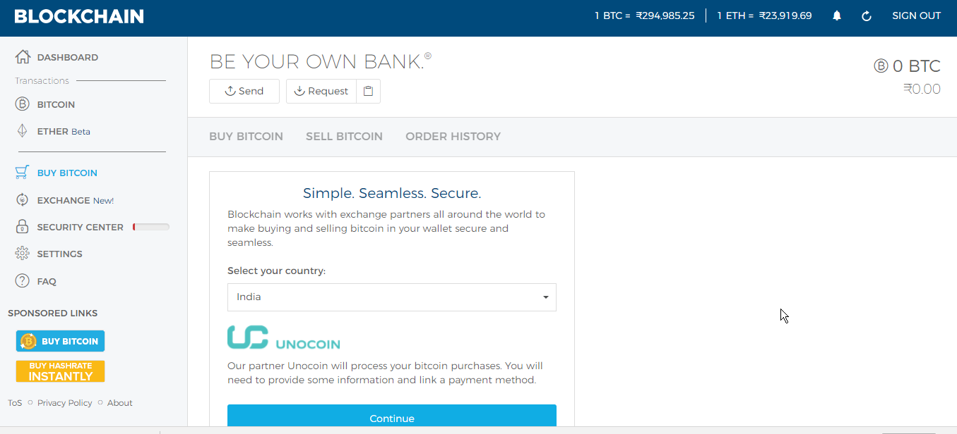
Wallet Example: Blockchain Wallet
1
Public key – 34 characters long 17fPhbmXDpye94FrNu9fnE9DztMKCxES47
Private key – 51 characters long
https://blockchain.info/wallet/#/

Slide 27
Mining

Slide 28
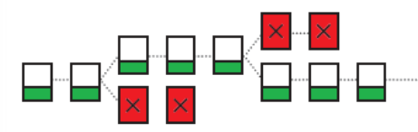
Creating an illegal Blockchain
In order to conclude an illegal transaction as a consensus in the Bitcoin blockchain, it is necessary to continue creating blocks faster than the authentic fork or re-create all past blocks
This requires a 50% or larger percentage of the total computing power necessary
It is much more economically rational to obtain rewards through proper mining, which discourages people from conducting illegal transactions
Trying to submit an altered block would change hash function of that block and all following blocks—nodes would detect and reject block

Slide 29
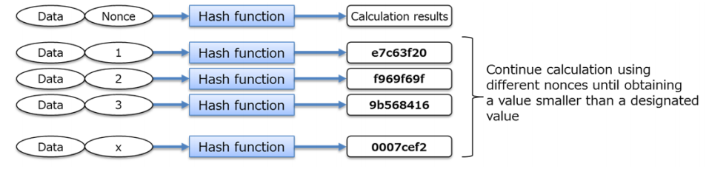
Proof Of Work
In Bitcoin, the security of the network relies on a proof of Work (POW) algorithm called mining.
Proof of work (Pow) should have the following properties
Any given PoW is easy to verify
The PoW is difficult to generate
The difficulty of the PoW is parametriziable
It should not be possible to reuse previously generated PoWs
It should not be possible to generate PoWs ahead of time and use them later.
POW is based on HashCash invented by Adam in 1997
https://www.youtube.com/watch?v=_160oMzblY8&t=637s&ab_channel=AndersBrownworth
and https://www.youtube.com/watch?v=GmOzih6I1zs&feature=youtu.be&ab_channel=BitcoinMiningCom

Slide 30
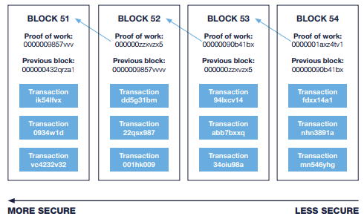
Security Increases as more blocks added
Source: Bryan, Garnier & Co

Slide 31
Blockchain Terminologies

Slide 32
Consensus
Is the collaborative process that the members of a blockchain business network use to agree that a transaction is valid and to keep the ledger consistently synchronized. Consensus mechanisms lower the risk of fraudulent transactions, because tampering with transactions added to the ledger would have to occur across many places at the same time.
To reach consensus, participants agree to the transaction and validate it before it is permanently recorded in the ledger. Participants can also establish rules to verify transactions. No one, not even a system administrator, can delete a transaction that has been added to the ledger. A trusted network of participants reduces the costs of establishing consensus, relative to the higher costs present in permissionless blockchains.
In a business blockchain, a wide variety of consensus mechanisms are available to choose from. Where trust is high, a simple majority voting may suffice, or the network may choose to use a more sophisticated method.

Slide 33
Smart contracts and chaincode
Smart contracts govern interactions with the ledger, and they can allow network participants to execute certain aspects of transactions automatically. For example, a smart contract could stipulate the cost of shipping an item that changes depending on when it arrives. With the terms agreed to by both parties and written to the ledger, the appropriate funds change hands automatically when the item is received.
In the context of Hyperledger Fabric, smart contracts are written into chaincode, and the terms are considered essentially synonymous.
A simple chaincode sample
Walk through a chaincode sample that shows you how to create assets on the ledger.
in Hyperledger Fabric, chaincode is a piece of code, written in Go, that defines the network assets and the transaction instructions (business logic) for modifying the assets. Chaincode is installed and instantiated onto a channel by an appropriately authorized member. When a transaction is invoked in that channel, a function in chaincode reads and writes values to the ledger.

Slide 34
Blockchain applications
A blockchain application requires three interdependent components:
User-facing application,
Smart contract, and
Ledger.
The top layer is the user-facing application that meets the needs of the network participants. The application lets users invoke smart contracts that trigger transactions in the business network.
The smart contract encapsulates the business logic of the network: assets, ownership, and transfers. Each invocation of a smart contract creates a transaction in the network and updates the ledger.
The ledger holds the current value of smart contract data (for example, vehicleOwner=Mr.X), and is distributed across the network.

Slide 35
Blockchain use cases
Internet of Things
Freight transportation: Move freight with multiple transportation companies, ensuring transparency and timely delivery
Component tracking and compliance: Store provenance records for original and replacement parts for fleet maintenance
Log operational maintenance data: Store operational and maintenance records for sharing among business partners or for regulatory purposes

Slide 36
Blockchain Use Case
Supply chain auditing
Consumers increasingly want to know that the ethical claims companies make about their products are real. Distributed ledgers provide an easy way to certify that the backstories of the things we buy are genuine. Transparency comes with blockchain-based timestamping of a date and location
AML and KYC
Anti-money laundering (AML) and know your customer (KYC) practices have a strong potential for being adapted to the blockchain. Currently, financial institutions must perform a labor intensive multi-step process for each new customer. KYC costs could be reduced through cross-institution client verification, and at the same time increase monitoring and analysis effectiveness.
Startup Polycoin (Israel) has an AML/KYC solution that involves analyzing transactions. Those transactions identified as being suspicious are forwarded on to compliance officers

Slide 37
Blockchain Use Case
Land title registration
As Publicly-accessible ledgers, blockchains can make all kinds of record-keeping more efficient. Property titles are a case in point. They tend to be susceptible to fraud, as well as costly and labour intensive to administer.
A number of countries are undertaking blockchain-based land registry projects.
This year, the Republic of Georgia cemented a deal with the Bitfury Group to develop a blockchain system for property titles. Reportedly, Hernando de Soto, the high-profile economist and property rights advocate, will be advising on the project.
Most recently, Sweden announced it was experimenting with a blockchain application for property titles.

Slide 38
Blockchain Use Case
Stock trading
The potential for added efficiency in share settlement makes a strong use case for blockchains in stock trading. When executed peer-to-peer, trade confirmations become almost instantaneous (as opposed to taking three days for clearance).
Potentially, this means intermediaries such as the clearing house, auditors and custodians get removed from the process.
Numerous stock and commodities exchanges are prototyping blockchain applications for the services they offer, including the ASX (Australian Securities Exchange), the Deutsche Börse (Frankfurt’s stock exchange) and the JPX (Japan Exchange Group).
Most high profile because the acknowledged first mover in the area, is the Nasdaq’s Linq, a platform for private market trading (typically between pre-IPO startups and investors).
A partnership with the blockchain tech company Chain, Linq announced the completion of it its first share trade in 2015. More recently, Nasdaq announced the development of a trial blockchain project for proxy voting on the Estonian Stock Market.

Slide 39

Blockchain Use Case
Smart Contract
Distributed ledgers enable the coding of simple contracts that will execute when specified conditions are met.
Use Case
Current scenario of travel insurance: 60% of the passengers insured against the delay of their flight never claimed their money
,A team created during a hackathon in London in 2015 an Automated Insurance system based on smart contracts.
With this service, passengers are automatically compensated when their fight is delayed, without having to fill out any form, and thus without the company having to process the requests.
The Blockchain's contribution here consists in generating the confidence and security necessary to automate the declarative phases without resorting to a third party.

Slide 40
Blockchain use cases
Financial services
Know Your Customer: Access to trusted up-to-date information on customers improves the accuracy of customer services in financial institutions
Clearing and settlement: Real-time point-to-point transfer of funds between financial institutions accelerates settlement
More examples: Letters of credit, Corporate debts and bonds, Trading platforms, Payment remittance, Repurchase agreements, and Foreign exchange
Healthcare
Electronic medical records
Virus banks
Doctor-vendor RFP services and assurance contracts
Blockchain health research commons
Blockchain health notaries
Insurance
Claims processing
P2P insurance
Ownership titles
Sales and underwriting
Government
Government tender processes
Voting
Taxes

Slide 41



Background of Bitcoin – Blockchain 1.0
Introduction Bitcoin

Slide 42
Traditional Currency vs. Cryptocurrency
MAKE
CONTROL
MAKE
CONTROL
Central banks
print notes and
mint coins that are
released into the
economy, largely
by retail banks in the form of loans.
Retail banks
continually monitor transactions for signs of suspicious activity. Anticounterfeit technology is built into the form of watermarks and security threads.
Secure encryption
is built in to the code of each virtual coin. Continually changing complex mathematical puzzles reduces counterfeiting.
“Miners” create virtual “coins” using special hardware. The coins are then registered on an online public ledger.
VALUE
$
VALUE
C
Cryptocurrencies become more valueable when they are easier to use, transaction time is faster and more secure, and the number of retailers using them rises.
Determined by economic factors and the amount of money in circulation. Central banks can devalue a currency by printing more of it.
STORE
STORE
Cryptocurrencies are held in the digital wallets of individuals. Records are kept on a virtual public ledger.
Money is held in banks with records of account holders.
TRANSFER
TRANSFER
Transactions are only
Possible via a bank account and they can be traced. Fees for international transfers can be high.
Anyone with online access can make transfers. Such transfers are virtually anonymous and fees low or negligible.

Slide 43
Characteristics of Money
Characteristics | Meaning
Unit of Account | Measurable , accounting notation
Medium of exchange | Simpler than barter
Portable | Fits in our pocket
Durable | Does not wear out quickly
Divisible | Can make change
Fungible | One is worth the same as another
Store of value | Holds its value over time (including commodity value and scarcity)
If it does not meet all these criteria, then it is not money , then it may be currency.

Slide 44

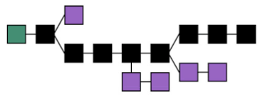
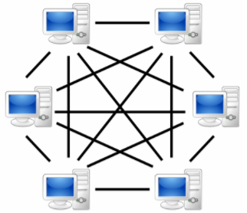


Technology behind Bitcoin
The Bitcoin network: a P2P Network like Bittorrent
Cryptography: Enables the exchange of accurate (payment) instructions between the parties of the transactions with digital signatures using public Cryptography.
Cyptorgraphic hash functions are used to enforce discipline on writing transaction records on public ledger
Blockchain Technology: It bundles together transactions in a chain of blocks and ensures transactions can be independently confirmed as unique and valid using distributed consensus mechanism without a central authority
Blockchain Technology
Cryptography
A P2P Bitcoin Network
Notes:
P2P network often called nodes, collectively validating and bundling batches of encrypted transactions together into code blocks. Each block is then added to the end of the chronological chain, stored not in one central location but, rather, synchronized on each node across the network

Slide 45

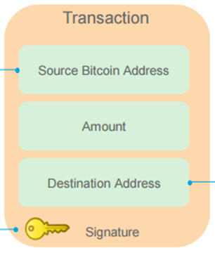
Typical bit coin Transaction
1
BOB
SALLY
Bob Bitcoin Address (Public)
Sally’s Bitcoin Address (Public)
Bob’s Account Private Key
Bitcoin address is a single –use Token

Slide 46
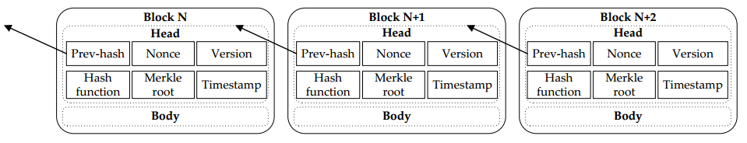
Bitcoin Block Structure
4
Block structure is shown here. 4 bytes is allocated for Block size and 80 bytes are allocated for Blockheader.
Field | Description | Size
Magic No | Value always 0xD9B4BEF9 | 4 bytes
Blocksize | Number of bytes following up to the end of block | 4 bytes
Blockheader | Consists of 6 items | 80 Bytes
Transaction Counter | Positive Integer VI - Varint | 1- 9 bytes
Transactions | The (non empty) list of transactions | <Transaction counter> many transactions

Slide 47
Bitcoin Transactions
1
A transaction is a transfer of value between Bitcoin Wallets that gets included in the Blockchain.
A Bitcoin transaction has 3 parts
1. Input 2. Output 3. Verification
Input is reference to an output from a previous transaction . Multiple inputs are often listed in the transactions to make up the value you want to transfer.
Output contains instructions for sending bitcoins. Value is the number of Satoshi(1BTC = 100,000,000 Satoshi) this output is worth when claimed
Verification – To verify that inputs are authorized to collect the values of referenced outputs.
Alice wants to transfer 5 BTC to Bob. Alice checked her previous transactions and found that she had one transaction output with 4 and another with 3 BTC.
So she needs combine these two transactions to make it 5 for Bob and another transaction output back to her 2 BTC.
Transaction

Slide 48
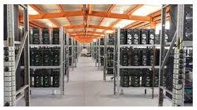

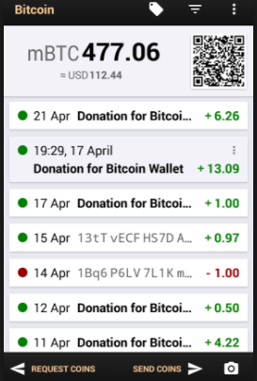







Bitcoin Operation
Cryptographic Challenge
Solving the Cryptographic Puzzle
Reward
Transaction
Validation
Block Added
1
2
Bitcoin Software
5
3a
3b
4a
4b
Wallet
Concensus
Distributed Ledger
Transaction Authentication
Finding Nonce
A miner solves the challenge
Miners Race to Solve the Challenge
The rest of the miner community verifies validity of the new block created
The new block of transaction is added to the bitcoin Blockchain.
Transaction Completed
The winning miner earns a reward for solving the challenge first
PK , Digital Signature,
Hash
1
2
Found the nonce
Verification
Approved the Block creation
Reward
Mining
3a
3b
4a
4b
5
Notes:
1. Transaction, 2. Cryptographic challenge, 3. Miners try to solve the puzzle, 4. one miner succeeds ,5a: consensus 5b. Creation of Block approved and added to the blockcahin 6: Reward for the miner

Slide 49
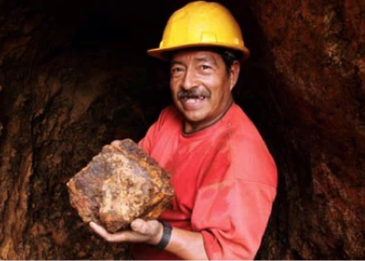
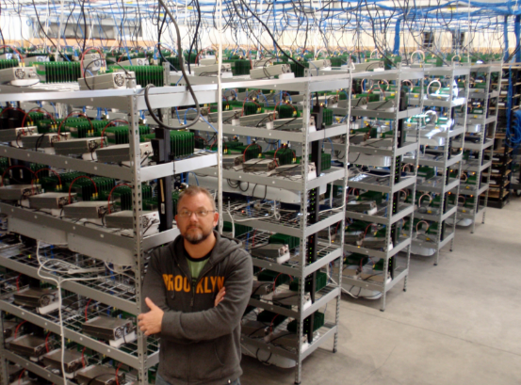
Where do Bitcoins come from?
3
Bitcoin miner creates a new block at every 10 minutes and gets 12.5 BTC as reward
In every 21000 transactions, difficulty level of solving the cryptographic puzzle is adjusted to maintain the time (10’)
The reward will be halved every 210000 blocks
There are currently 16million BTC in circulation and there is a cap of 21M BTC as per the rules and the cap will be reached by 2140 AD
Process and conform Transactions
Solve specific math problems in competition
Bitcoin awarded to winner (12.5BTC)
Every 10 minutes
Currently 16M in circulation
21M CAP will be reached by 2140 AD
http://www.bitcoinblockhalf.com/

Slide 50
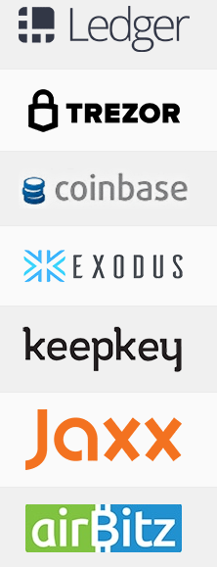
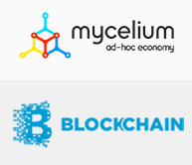

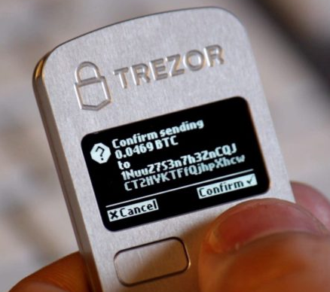
Bitcoin Wallets
1
Two types of wallet, software based and hardware based
Bitcoin hardware wallets are the most secure type of Bitcoin wallet.
What differentiates hardware wallets from software wallets is that when they are plugged out—in “cold storage.”
Your hardware wallet is disconnected from the Internet and impossible to touch.
Hackers, Trojans, and other malware can’t get to anything in cold storage.
Notes:
There basically two different kinds of wallets. Software based and hardware based wallets. Some of the important wallets are reviewed https://coincentral.com/best-bitcoin-wallet-reviews/
Software based wallets (Client) is always on and is prone to hacking attacks. The hardware based wallets are offline most of the time and is getting connected when you want to do some transaction. So it is supposed to be relatively safe. But there were incidents of security breach even in hardware based wallet.

Slide 51
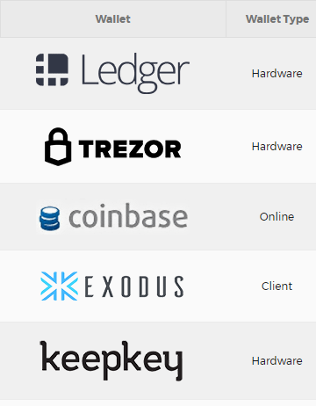

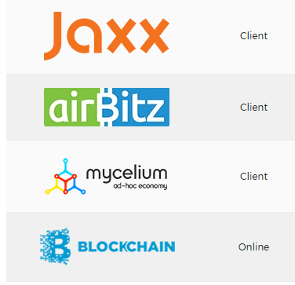

Bitcoin Wallets
1
Client based wallets have mobile apps
Notes:
Some of the most popular soft as well as hardware based wallets are listed here.

Slide 52
Miners
Miners can be three types, Individuals, Group / Pool and Professional. Mining requires lots of computational power and electricity. In early days people mined using a single Laptop. Now with the number of transactions increasing, the CPU power requirement has gone up a lot. We need specialized hardware to mine which often extremely difficult so many miners join together as a group and mine so that they are more success.
Individuals
Setup with a single computer to mine bitcoins
The investment in equipment and energy now needed to be successful are high, so individual miners are now rare
Group or Pool
Several people or organizations pool their computing power to maximize their probability of success in validating a block
Each miner receives payment based on the total volume of bitcoins received by the group, in proportion to the power that was made available to the community
Professional
Highly organized professional mining companies have developed techniques for mastering the mining chain from end to end and maximizing use of their hardware and computing power

Slide 53
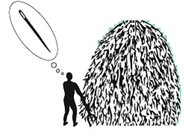
Mining
3
Miners are responsible for creating new block which involves lots of computational work. So they are rewarded with new bitcoins, so the name miners
Miners have no way to predict which nonce will produce a hash value with the required number of leading zeroes
Miners need to try with as many random nonce needed to arrive at the hash value desired
Miners are responsible for:
detecting transaction requests from users
Verifying a transaction
Aggregating transactions into a block
Mining new block
Validating the new block
Creating hashes is computationally trivial, but the Bitcoin System requires that the new hash value have a particular form, specifically it starts with a certain number of zeros.
The term miner must not be compared with a gold or coal miner in the real world.
While a gold miner digs into the earth to discover gold, a blockchain miner uses computational power to calculate hashes.
https://www.youtube.com/watch?v=e25IeoDhTSA&ab_channel=DillonHutchins
Notes:
Miners are part of the same Bitcoin network and are responsible for detecting transaction requests from users, aggregates them , validates them and adding them to blocochain as new blocks
Miners group bitcoin transactions into blocks, and then apply a mathematical formula to the block, called a “hash”. Because this also includes the hash of the previous block, it confirms that this block is valid and it acts as the foundation for the following block. The bitcoin protocol deliberately makes it difficult to create a valid hash, by demanding that it must start with a certain number of zeros. It therefore requires a great deal of computing power and the resulting valid hash is called a “proof of work”. Miners compete to validate blocks and are incentivized for their work by payment in bitcoins: in effect, the process creates new currency.

Slide 54
Miner’s Algorithm - Simplified
The block chain serves to confirm transactions to the rest of the network as having taken place
Bitcoin nodes use the block chain to distinguish legitimate Bitcoin transactions from attempts to re-spend coins that have already been spent elsewhere
Mining is intentionally designed to be resource-intensive and difficult so that the number of blocks found each day by miners remains steady
Individual blocks must contain a proof of work to be considered valid
This proof of work is verified by other Bitcoin nodes each time they receive a block
Courtsey: https://www.niceideas.ch/roller2/badtrash/entry/blockchain-explained-beta

Slide 55
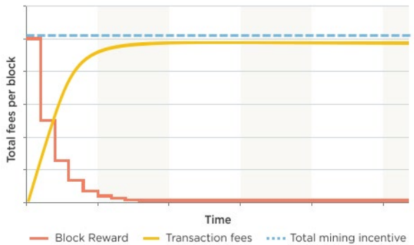
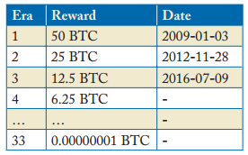
Incentive for Miners for Block Creation
Miner gets a reward of newly mined 12.5BTC and transaction fees.
Block reward is halved in every 2100000 blocks which becomes 0 by 2140, 33rd phase
In the coming years as he transactions increase, transaction fees are meant to replace block rewards
Notes:
Incentives of mining is mainly the reward the miners earn for solving each puzzle and the transaction fees. As the time goes by the mining rewards decreases but the amount earned through transaction fees increases . So in the future it will become almost steady.

Slide 56

Nodes in Bitcoin Ledger
https://bitnodes.21.co
Notes:
The figure shown gives

Slide 57
Mining Hardware and Software
Get mining hardware http://profit.hashflare.eu/en/?ref_id=539A7635)
Download free bitcoin Mining software https://www.bitcoinmining.com/bitcoin-mining-software/
Join a Bitcoin Mining Pool http://p2pool.in/
Setup Bitcoin Wallet
Stay up to date with Bitcoin news
Mining needs specialized hardware to be successful. These equipped with ASICS specialized for solving this puzzle. Mining hardware is available from many vendors Avalon, Bitfury etc..

Slide 58
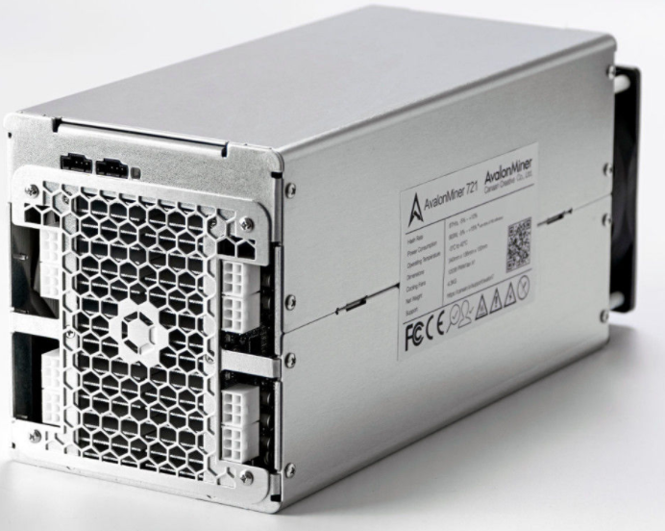
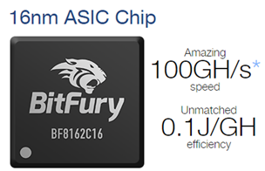
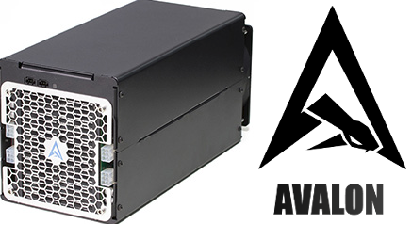

Mining Hardware and Software
3
4
Normal Desktop will take 36 years to compute the bitcoin nonce at present !!
Avalon Project, BitFury, BitMain, Butterfly Labs, innoSilicon, KnCMiner and SFard

Slide 59
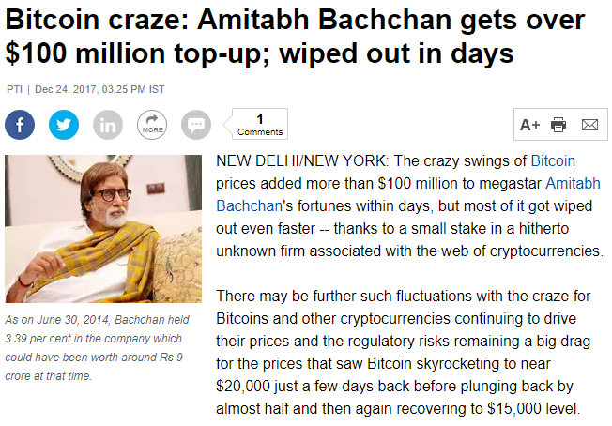
A word of caution !!!
https://economictimes.indiatimes.com/markets/stocks/news/bitcoin-craze-amitabh-bachchan-gets-over-100-million-top-up-wiped-out-in-days/articleshow/62230604.cms

Slide 60

Break for discussion
Notes:
Guide the teams to conclude:
Solutions now exist for problems that were earlier solved only by experts.
Connect these concepts to technology so that the participants get glimpses of AI.

Slide 61

Thank you

Slide 62
Blockchain
Shared, trusted, public ledger of transactions, that everyone can inspect but which no single user controls. It is a cryptographed, secure, tamper-resistant distributed database. It solves a complex mathematical problem to exist.
Block chain is a perfect place to store value, identities, agreements, property rights, credentials, etc. Once you put something like a Bitcoin into it, it will stay there forever. It is decentralized, disintermediated, cheap and censorship-resistant.
Applications of Blockchain: Bitcoin (cryptocurrency), Namecoin (wants to replace the entire DNS system of the Internet), or Sia (a decentralized cloud storage), Ethereum (Turing complete Virtual Machine where you can run any smart contract); Any centralized service like eBay, Dropbox can potentially be built in a decentralized way using blockchain technology, considerably lowering transaction costs.

Slide 63
Block (on the Bitcoin Blockchain)
Data is permanently recorded on the Bitcoin network through files called blocks. A block is a record of some or all of the most recent Bitcoin transactions that have not yet been recorded in any prior blocks. New blocks are added to the end of the record (known as the blockchain), and can never be changed or removed once written (although some software will remove them if they are orphaned).
Each block memorializes what took place in the minutes before it was created. Each block contains a record of some or all recent transactions and a reference to the block that came immediately before it. It also contains an answer to a difficult-to-solve mathematical puzzle – the answer to which is unique to each block. New blocks cannot be submitted to the network without the correct answer – the process of “mining” is essentially the process of competing to be the next to find the answer that “solves” the current block.
The mathematical problem in each block is extremely difficult to solve, but once a valid solution is found, it is very easy for the rest of the network to confirm that the solution is correct. There are multiple valid solutions for any given block – only one of the solutions needs to be found for the block to be solved. Because there is a reward of brand new bitcoins for solving each block, every block also contains a record of which Bitcoin addresses or scripts are entitled to receive the reward.

Slide 64
Block (on the Bitcoin Blockchain)
This record is known as a generation transaction, or a coinbase transaction, and is always the first transaction appearing in every block. The number of Bitcoins generated per block starts at 50 and is halved every 210,000 blocks (about four years). Bitcoin transactions are broadcast to the network by the sender, and all peers trying to solve blocks collect the transaction records and add them to the block they are working to solve.
Miners get an incentive to include transactions in their blocks because of attached transaction fees. The difficulty of the mathematical problem is automatically adjusted by the network, such that it targets a goal of solving an average of 6 blocks per hour. Every 2016 blocks (solved in about two weeks), all Bitcoin clients compare the actual number created with this goal and modify the target by the percentage that it varied. The network comes to a consensus and automatically increases (or decreases) the difficulty of generating blocks. Because each block contains a reference to the prior block, the collection of all blocks in existence can be said to form a chain.
However, it’s possible for the chain to have temporary splits – for example, if two miners arrive at two different valid solutions for the same block at the same time, unbeknownst to one another. The peer-to-peer network is designed to resolve these splits within a short period of time so that only one branch of the chain survives. The client accepts the ‘longest’ chain of blocks as valid. The ‘length’ of the entire blockchain refers to the chain with the most combined difficulty, not the one with the most blocks. This prevents someone from forking the chain and creating a large number of low-difficulty blocks and having it accepted by the network as ‘longest

Slide 65
Block explorer
An online tool for exploring the blockchain of a particular cryptocurrency, where you can watch and follow live all the transactions happening on the blockchain. Block explorers can serve as blockchain analysis and provide information such as total network hash rate, coin supply, transaction growth, etc.

Slide 66
Block reward
An amount of crypto-currency a miner receives for processing transactions in a given block. Because creating (or “mining”) blocks is so crucial to the security of the Bitcoin network and yet so hard, the Bitcoin protocol includes a mechanism to encourage people to mine: every time a block is added, the miner who found the block is given 12,5 BTC(this number will change at the next halving in 2020) as a block reward

Slide 67
Consensus (general)
A fundamental problem in distributed computing is to achieve overall system reliability in the presence of a number of faulty processes. This often requires processes to agree on some data value that is needed during computation. The consensus problem requires agreement among a number of processes for a single data value. Some of the processes may fail or be unreliable in other ways, so consensus protocols must be fault tolerant. The processes must somehow put forth their candidate values, communicate with one another, and agree on a single consensus value. The bitcoin blockchain uses electricity to ensure the security of the system. It creates an economic system where you can only participate by incurring costs, Proof of work (POW). You do that for the possibility of reward/bitcoin. If you spend money, and you play fair by the rules, you get money back. If you cheat, you lose money. It doesn’t pay to cheat. This simple game theoretical equilibrium is the core of the bitcoin consensus algorithm

Slide 68
Consortium blockchains
A consortium blockchain is a blockchain where the consensus process is controlled by a pre-selected set of nodes; for example, one might imagine a consortium of 15 financial institutions, each of which operates a node and of which ten must sign every block for the block to be valid. The right to read the blockchain may be public or restricted to the participants. There are also hybrid routes such as the root hashes of the blocks being public together with an API that allows members of the public to make a limited number of queries and get back cryptographic proofs of some parts of the blockchain state. These blockchains may be considered “partially decentralized”

Slide 69
Cryptographic Hash Function
The cryptographic hash function is a mathematical algorithm that takes a particular input which can be any kind of digital data be it a password or jpeg file and produces a single fixed length output. Some examples of different hash function algorithms are MD5, MD4 or SHA256. The last one is used in the Bitcoin protocol. Main properties: (1) easy to compute hash value for any given message (2) infeasible to generate a message from its hash except by trying all possible input combinations(brute force attack) (3) infeasible to modify a message without changing the hash (4) infeasible to find two different messages with the same hash (5) deterministic so the same message always results in the same hash. Cryptographic hash functions have many information security applications, notably in digital signatures, message authentication codes (MACs), and other forms of authentication. They can also be used as ordinary hash functions, to index data in hash tables, for fingerprinting, to detect duplicate data or uniquely identify files, and as checksums to detect accidental data corruption

Slide 70
dApp (decentralized application)
For an application to be considered a Dapp or decentralized application it must meet the following criteria
Application must be completely open-source, it must operate autonomously, and with no entity controlling the majority of its tokens. The application may adapt its protocol in response to proposed improvements and market feedback, but all changes must be decided by consensus of its users.
Application data and records of operation must be cryptographically stored in a public, decentralized blockchain in order to avoid any central points of failure.
The application must use a cryptographic token (bitcoin or a token native to its system) which is necessary for access to the application, and any contribution of value from miners/farmers should be rewarded with the application’s tokens.
The application must generate tokens according to a standard cryptographic algorithm acting as a proof of the value nodes are contributing to the application (Bitcoin uses the Proof of Work Algorithm)

Slide 71
DAOs (Decentralized Autonomous Organization)
Fully automated business entity (FAB), or distributed autonomous corporation/company (DAC) is a decentralized network of narrow-AI autonomous agents which perform an output-maximizing production function and which divides its labor into computationally intractable tasks (which it incentivizes humans to do) and tasks which it performs itself. It can be thought of as a corporation run without any human involvement under the control of an incorruptible set of business rules. These rules are typically implemented as publicly auditable open-source software distributed across the computers of their stakeholders. A human becomes a stakeholder by buying stock in the company or being paid in that stock to provide services for the company. This stock may entitle its owner to a share of the profits of the DAO, participation in its growth, and/or a say in how it is run.

Slide 72
Digital Signature
Private keys are used for signing transactions. Each time a transaction is sent over the blockchain it gets signed by the user’s private key. The signed transaction is broadcasted over the network together with the corresponding public key. Each miner is able to verify the signature by verifying the signature with the public key.

Slide 73
Double Spending
Double-spending is the result of successfully spending some money more than once. Bitcoin is the first to implemented a solution in early 2009 which protects against double spending by verifying each transaction added to the blockchain to ensure that the inputs for the transaction had not previously already been spent.

Slide 74
Ethereum
Ethereum is an open software platform based on blockchain technology that enables developers to write smart contracts and build and deploy decentralized applications(Dapps). The native token of the blockchain is called Ether which is used to pay for transaction fees, miner rewards and other services on the network. The main innovation of Ethereum is the Ethereum Virtual Machine (EVM) which runs on the Ethereum network and enables anyone to run any application. The EVM makes the process of developing blockchain applications much easier. Before the emergence of Ethereum developers had to develop a dedicated blockchain for each application they wanted to create. This process is time-consuming and resource-intensive. Ethereum will enable the development of many applications on the same platform, making the process much easier and accessible for developers. The Ethereum Project, based in Switzerland, raised millions in seed money by pre-mining and selling ethers to supporters & investors. As opposed to Bitcoin, its scripting language is Turing-complete and full-featured, expanding the kinds of smart contracts that it can support. The Ethereum project wants to “decentralize the web” by introducing four components as part of its roadmap: static content publication, dynamic messages, trustless transactions and an integrated user-interface

Slide 75
Merkle tree
The basic idea behind Merkle tree is to have some piece of data that is linking to another. You can do this by linking things together with a cryptographic hash. The content itself can be used to determine the hash. By using the cryptographic hashing we can address the content, and content gets immutable because if you change anything in the data, the cryptographic hash changes and the link will be different. Bitcoin uses cryptographic hashing, where every block points to the previous one if you modify the block, the hash will change and will make the block invalid

Slide 76
Mining (Bitcoin)
Mining is the process of adding transaction records to Bitcoin’s public ledger of past transactions or blockchain. This ledger of past transactions is called the blockchain as it is a chain of blocks. The blockchain serves to confirm transactions to the rest of the network as having taken place. Bitcoin nodes use the blockchain to distinguish legitimate Bitcoin transactions from attempts to re-spend coins that have already been spent elsewhere. Mining is intentionally designed to be resource-intensive and challenging so that the number of blocks found each day by miners remains steady. Individual blocks must contain a proof of work to be considered valid. This proof of work is verified by other Bitcoin nodes each time they receive a block. Bitcoin uses the hashcash proof-of-work function. The primary purpose of mining is to allow Bitcoin nodes to reach a secure, tamper-resistant consensus. Mining is also the mechanism used to introduce Bitcoins into the system: Miners are paid any transaction fees as well as a “subsidy” of newly created coins. This both serves the purpose of disseminating new coins in a decentralized manner as well as motivating people to provide security for the system

Slide 77
Oracles
Smart contracts on the blockchain cannot access the outside network on their own. Therefore oracles sit between a smart contract and the external world, providing the data needed by the smart contract to prove performance while sending its commands to external systems

Slide 78
Private Blockchains
A fully private blockchain is a blockchain where write permissions are kept centralized to one organization. Read permissions may be public or restricted to an arbitrary extent. Likely applications include database management, auditing, etc. internal to a single company, and so public readability may not be necessary in many cases at all, though in other cases public auditability is desired

Slide 79
Private key
Each time a user runs a cryptocurrency wallet for the first time a public-private key pair gets generated. The private key is a randomly generated number which allows users to transact over the blockchain. It is locally stored and kept secret. Each time a Bitcoin gets sent a private key has to sign the transaction. This action is automatically executed by the wallet software. When a wallet asks users to do a backup what this means is that the users must secure their private key. There are different types of wallets such as online wallets, mobile wallets, desktop wallet, hardware wallets or paper wallets. The category of each wallet is determined by where private keys are stored. Online wallets are mostly provided by exchanges and keep user’s private keys on their servers. If the service provider goes offline users would lose access to their funds. Hardware wallets for example store user’s private keys in a secure device which looks like a USB flash drive.

Slide 80
Proof of Authority(PoA)
A Proof of authority is a consensus mechanism in a private blockchain which essentially gives one client(or a specific number of clients) with one particular private key the right to make all of the blocks in the blockchain

Slide 81
Proof of Stake
Proof-of-stake (PoS) is a method by which a cryptocurrency blockchain network aims to achieve distributed consensus. While the proof-of-work (PoW) method asks users to repeatedly run hashing algorithms or other client puzzles, to validate electronic transactions, proof-of-stake asks users to prove ownership of a certain amount of currency (their “stake” in the currency). Peercoin was the first cryptocurrency to launch using proof-of-Stake. Other prominent implementations are found in BitShares, Nxt, BlackCoin, NuShares/NuBits and Qora. Ethereum has planned a hard fork transition from PoW to PoS consensus. Decred hybridizes PoW with PoS and combines elements of both in an attempt to garner the benefits of the two systems and create a more robust notion of consensus. With Proof of Work, the probability of mining a block depends on the work done by the miner (e.g. CPU/GPU cycles spent checking hashes). In the case of Bitcoin, with Proof of Stake, the resource that’s compared is the amount of Bitcoin a miner holds – someone holding 1% of the Bitcoin can mine 1% of the “Proof of Stake blocks”. Instead of sacrificing energy to mine a block, a user must prove they own a certain amount of the cryptocurrency to generate a block. The more stake you own, the more likely you are to generate a block. In theory, this should prevent users from creating forks because it will devalue their stake and it should save a lot of energy. Proof of Stake sounds like a good idea, but ironically, there is the “Nothing at Stake” problem. Since mining Bitcoins is costly, it is not smart to waste your energy on a fork that won’t earn you any money, however with Proof of Stake, it is free to mine a fork

Slide 82
Proof of Work
POW system/protocol/function is an economic measure to deter denial of service attacks and other service abuses such as spam on a network by requiring some work from the service requester, usually meaning processing time by a computer. The concept may have been first presented by Cynthia Dwork and Moni Naor in a 1993 journal. The term “Proof of Work” was first coined and formalized in a 1999 paper by Markus Jakobsson and Ari Juels. A key feature of these schemes is their asymmetry: the work must be moderately hard (but feasible) on the requester side but easy to check for the service provider. This idea is also known as a CPU cost function, client puzzle, computational puzzle or CPU pricing function

Slide 83
Public Blockchains
A public blockchain is a blockchain that anyone in the world can read, anyone in the world can send transactions to and expect to see them included if they are valid, and anyone in the world can participate in the consensus process – the process for determining what blocks get added to the chain and what the current state is. As a substitute for centralized or quasi-centralized trust, public blockchains are secured by crypto economics – the combination of economic incentives and cryptographic verification using mechanisms such as proof of work or proof of stake, following a general principle that the degree to which someone can have an influence in the consensus process is proportional to the quantity of economic resources that they can bring to bear. These blockchains are generally considered to be “fully decentralized”

Slide 84
Satoshi
The smallest unit of Bitcoin, equal to 0.00000001 BTC

Slide 85
Satoshi Nakamoto
Satoshi Nakamoto is a person or group of people who created the bitcoin protocol and reference software, Bitcoin Core (formerly known as Bitcoin-Qt). In 2008, Nakamoto published a paper on The Cryptography Mailing list at metzdowd.com describing the bitcoin digital currency. In 2009, they released the first bitcoin software that launched the network and the first units of the bitcoin cryptocurrency, called bitcoins

Slide 86
SHA (Secure Hash Algorithm)
SHA is a family of cryptographic hash functions published by the National Institute of Standards and Technology (NIST) as a U.S. Federal Information Processing Standard (FIPS). SHA256 is an algorithm used in Bitcoin that takes an input of any size which can be any form of data(text, jpeg, pdf, etc.), mixes it up and creates a fixed size output(a hash) which is 256-bit (32-byte) long . You can think of the hash as the fingerprint of the data. Hashes are one-way functions – they cannot be decrypted back. The only way to decrypt a hash is by brute forcing it. Brute force means to systematically try all the combinations for an input. Brute force attack will always find the input, no matter its complexity. The downside is whether or not you will still be alive when it finally guesses it

Slide 87
Smart contracts
Smart Contracts are computer protocols that facilitate, verify, or enforce the negotiation or performance of a contract, or that obviate the need for a contractual clause. Smart contracts usually also have a user interface and often emulate the logic of contractual clauses. Proponents of smart contracts claim that many kinds of contractual clauses may thus be made partially or fully self-executing, self-enforcing, or both. Smart contracts aim to provide security superior to traditional contract law and to reduce other transaction costs associated with contra

Slide 88
SPV(Simplified Payment Verification) client
SPV clients are Bitcoin lightweight clients which do not download and store the whole blockchain locally. These wallets provide a way to verify payments without having to download the complete blockchain. An SPV client only downloads the block headers by connecting to a full node

Slide 89
Token
In the context of Blockchains, a token is a digital identity for something that can be owned. Historically, tokens started as meta information encoded in simple Bitcoin transactions, thereby taking advantage of the Bitcoin blockchain’s strong immutability. At a protocol layer, tokens were outsourced extensions to Bitcoin’s core protocol. Instead of being integrated as a feature on a software level, those tokens were created by misappropriating data fields in Bitcoin transactions (such as encoding data in the amount or op_return field). Today, modern tokens are created as sophisticated smart contract systems with complex permission systems and interaction paths attached. Smart contracts can be understood as software agents, which act deterministically and autonomously, within the scope of a given network, according to a predefined rule set. If the governance rules around issuance and management of a token are sufficiently complex regarding how they coordinate a group of stakeholders, token smart contracts may be understood as organizations sui generis. The management rules may reflect those of known legal, organizational entities such as stock corporations, but they do not have to

Slide 90
Testnet
A second blockchain used by developers for testing new versions of client software without putting a real value at risk

Slide 91
Transaction Fees (Bitcoin)
Transactions may be included with any transfer of bitcoins from one address to another. At the moment, many transactions are typically processed in a way where no fee is expected at all, but for transactions which draw coins from many bitcoin addresses and therefore have a large data size, a small transaction fee is usually expected. The transaction fee is processed by and received by the bitcoin miner. When a new bitcoin block is generated with a successful hash, the information for all of the transactions is included with the block, and all transaction fees are collected by that user creating the block, who is free to assign those fees to himself. Transaction fees are voluntary on the part of the person making the bitcoin transaction, as the person attempting to make a transaction can include any fee or none at all in the transaction. On the other hand, nobody mining new bitcoins necessarily needs to accept the transactions and include them in the new block being created. The transaction fee is, therefore, an incentive on the part of the bitcoin user to make sure that a particular transaction will get included in the next block which is generated. It is envisioned that over time the cumulative effect of collecting transaction fees will allow somebody creating new blocks to “earn” more bitcoins that will be mined from new bitcoins created by the new block itself. This is also an incentive to keep trying to create new blocks even if the value of the newly created block from the mining activity is zero in the far future

Slide 92
Turing completeness
A machine is Turing complete if it can perform any calculation that any other programmable computer is capable of. All modern computers are Turing-complete in this sense. The Ethereum Virtual Machine (EVM) which runs on the Ethereum blockchain is Turing complete. Thus it can process any “computable function”. It is, in short, able to do what you could do with any conventional computer and programming language

Slide 93
Example:
Here is an extremely simplified sketch of the problem, but it should give a pretty good idea of what the problem is:
The Data:
This is the hash of the lastest block (shortened to 30 characters):
00000000000001adf44c7d69767585
These are the hashes of a few valid transactions waiting for inclusion (shortened).
5572eca4dd4
db7d0c0b845
And this the hash of one special transaction that you just crafted, which gives 25BTC (the current reward) to yourself:
916d849af76
Building the next block:
Now, let's use a gross approximation of what a new block might look like (the real one uses binary format). It contains the hash of the previous block and the hashes of those 3 transactions:
00000000000001adf44c7d69767585--5572eca4dd4-db7d0c0b845-916d849af76--

Slide 94
Example:
Now let's do mining by hand! Our goal is to complete this block with a nonce (a piece of garbage) such that the hash of the new block starts with 13 zeros (considering the previous hash, it seems that 13 zeroes is the current difficulty!).
Mining (trying to finalize this block):
Let's try with nonce=1, and compute the hash of the block (I'm using the md5 hash algorithm, but Bitcoin uses double sha256):
> echo "00000000000001adf44c7d69767585--5572eca4dd4-db7d0c0b845-916d849af76--1" | md5sum
8b9b994dcf57f8f90194d82e234b72ac
No luck, the hash does not start with a 0… Let's try with nonce=2
> echo "00000000000001adf44c7d69767585--5572eca4dd4-db7d0c0b845-916d849af76--2" | md5sum
5b7ce5bcc07a2822f227fcae7792fd90
No luck…

Slide 95
Example:
If we pursue until nonce=16, we get our first leading zero.
> echo "00000000000001adf44c7d69767585--5572eca4dd4-db7d0c0b845-916d849af76--16" | md5sum
03b80c7a34b060b33dd8fbbece79cee3
For nonce=208, we get two leading zeroes!
> echo "00000000000001adf44c7d69767585--5572eca4dd4-db7d0c0b845-916d849af76--208" | md5sum
0055e55df5758517c9bed0981b52ce4a
Continue like this… If you finally find a hash that has 13 leading zeroes… you're a winner! Other miners will now build upon your block, you've just got 25BTC.
But you'll have to be fast!
Back to step 1…
If someone manages to build a block before you do, you'll have to start again from the beginning with the new block's hash (the one of the winner).

